Slide 1

Nayden Gochev’s
Hitchhiker's Guide to the JavaFX Galaxy

Slide 2


Who is Nayden Gochev ?
1
Nayden Gochev
Solution Architect
Solution Architect at Nemesis Software with with more than 12 years of experience. Developer, Trainer and consultant in many international companies and Bulgarian companies., took part in many conferences, seminars, technical trainings in multiple academic and non academic structures and companies. One of the organizers of jPrime and jProfessionals conferences and the monthly Bulgarian Java User Group seminars.
Huge Java fan with love for all *.java and big community supporter.
My personal blog can be found at gochev.org

Slide 3
What is JavaFX ?
2
JavaFX started as a project called F3 in Sun Microsystems by Chris Oliver in 2005
JavaFX initially was not an API but actually a declarative Java scripting language.
Sun Microsystems saw an opportunity and in 2007 rebranded F3 to JavaFX and the Script to JavaFX Script
JavaFX 1.0 was released in December 2008 containing the Script + a lot of components ready to be used
JavaFX 1.1 was released in 2009 with an official support for Java FX Mobile + improvements
Java FX 1.2 was released in 2009 with Layouts support + CSS skinning , Charts Widgets
JavaFX 1.3 was release in 2010 with performance improvements
JavaFX 2.0 was released in October 2011 as the biggest release after 1.0 containing :
• Java FX Script support was dropped permanently.
• Support for high performance lazy binding, binding
expressions
• Dropping support for JavaFX Mobile.
• Oracle announcing its intent to open source JavaFX.
JavaFX 2.0 makes use of a new declarative XML language called FXML.
Java FX 2.1 was released in 2012 adding Mac OS support, H.264/MPEG-4 AVC and Advanced Audio Coding support, new UI components and WebView component allowing JavaScript to Java method calls
JavaFX 2.2 was released in 2012 also with Linux support, Canvas and other components, touch support and gestures, Image manipulation API and Native packaging.
JavaFX 8 is the latest version part of JDK 8 with support for 3D graphics

Slide 4
What the FCUK is JavaFX ?!?!
3
import javafx.application.Application;
import javafx.stage.Stage;
public class JavaFXHelloWorld extends Application {
@Override
public void start(Stage primaryStage) throws Exception {
primaryStage.setTitle("Hello World!");
primaryStage.show();
}
public static void main(String[] args) {
launch(args);
}
}

Slide 5
What is Scene ?
4
public class JavaFXSceneBlack extends Application {
@Override
public void start(Stage stage) {
Group root = new Group();
Scene scene = new Scene(root, 500, 500, Color.BLACK);
stage.setTitle("JavaFX Scene Graph Demo");
stage.setScene(scene);
stage.show();
}
public static void main(String[] args) {
launch(args);
}
}

Slide 6
Sorry SIRI Scene, Stage WTF?
5
JavaFX uses the idea of Stage and Scene.
The Scene contains everything we want to show.
Stage always points to a single Scene that is currently “happening” and show its content.
We may have multiple Scenes in our application and switch them on demand.
All UI components like Buttons, Labels, Panels we mix in a Scene together with their animations and event handlers.

Slide 7
Again code using a Scene, please ?
6
@Override
public void start(Stage primaryStage) throws Exception {
Button btn = new Button();
btn.setText("Say 'Hello World'");
btn.setOnAction(new EventHandler<ActionEvent>() {
@Override
public void handle(ActionEvent event) {
System.out.println("Hello World!");
}
});
StackPane root = new StackPane();
root.getChildren().add(btn);
Scene scene = new Scene(root, 300, 250);
primaryStage.setTitle("Hello World!");
primaryStage.setScene(scene);
primaryStage.show();
}

Slide 8
And you said something about animations ?
7
We will speak about that later, first lets talk about Mixing components.
In order to Mix components you use Layouts.. ops Panels. In JavaFX each Pane has already an Layout set.
So we mix Panels containing Mix of components or other panels.

Slide 9
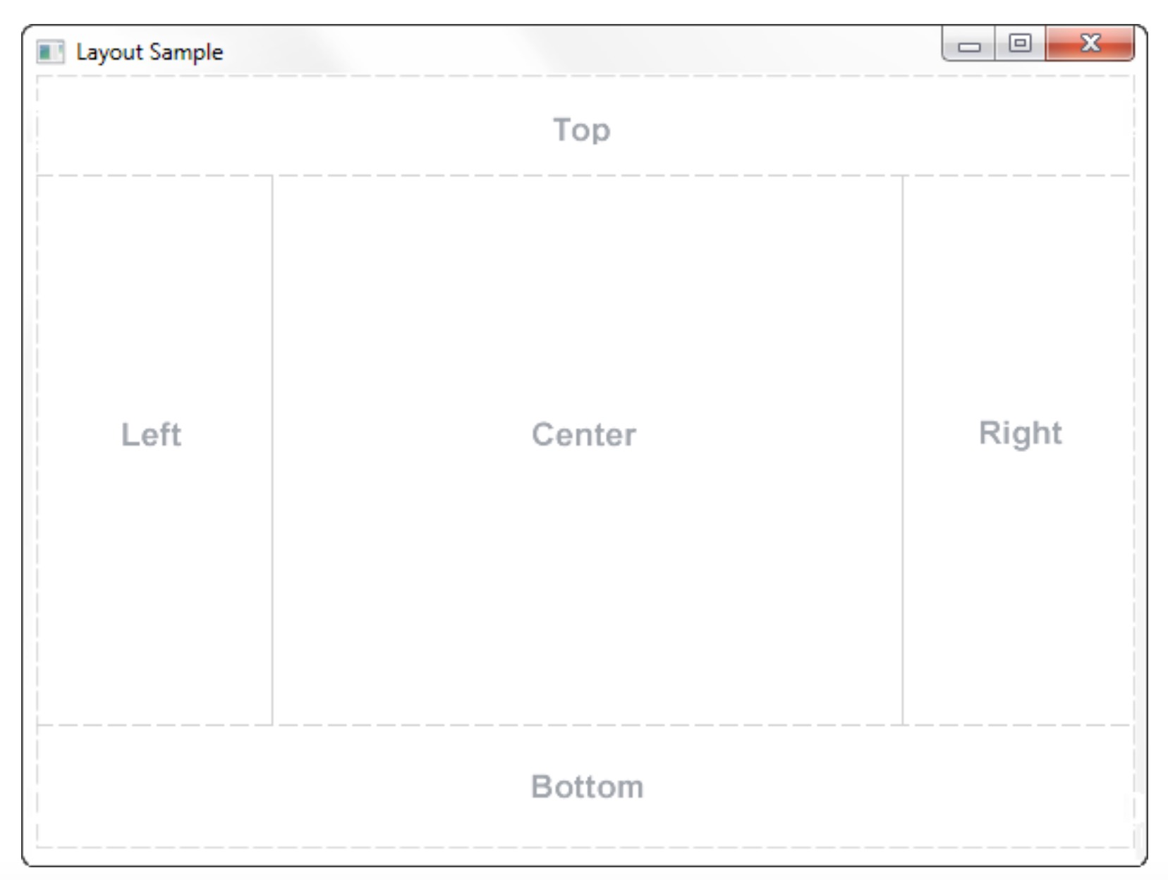
What Layouts, ops Panels we can use?
8
JavaFX Border Pane
BorderPane border = new BorderPane();
border.setTop(somenode);
border.setLeft(anotherNode);
border.setCenter(anotherNode);
border.setRight(andAnotherOne);

Slide 10
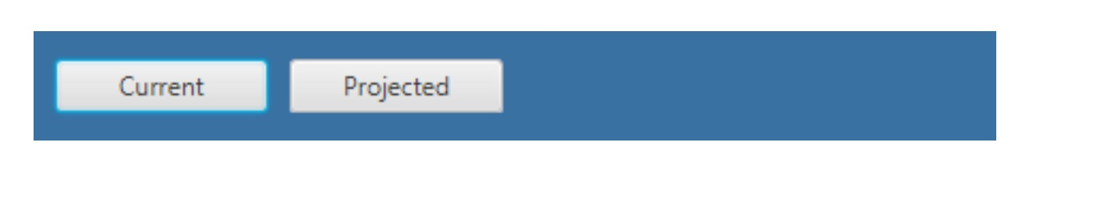
9
HBox Pane
HBox hbox = new HBox();
hbox.setPadding(new Insets(15, 12, 15, 12)); hbox.setSpacing(10);
hbox.setStyle("-fx-background-color: #336699;”);
Button buttonCurrent = new Button("Current"); buttonCurrent.setPrefSize(100, 20);
Button buttonProjected = new Button("Projected"); buttonProjected.setPrefSize(100, 20); hbox.getChildren().addAll(buttonCurrent, buttonProjected);

Slide 11


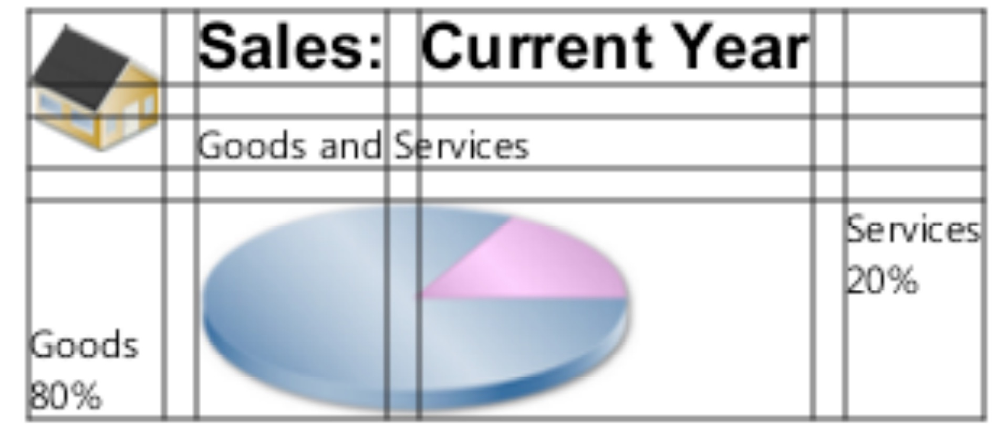
10
VBox Pane
Stack Pane (stacks all nodes on top of each other)
GridPane

Slide 12
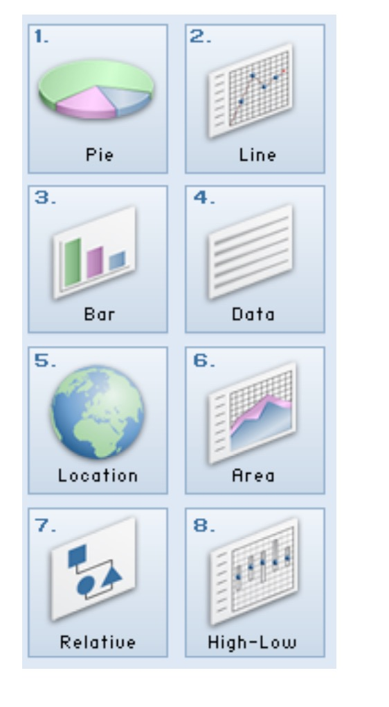
11
FlowPane
and and awesome The AnchorPane that enables you to anchor nodes to the top, bottom, left side, right side, or center of the pane. As the window is resized, the nodes maintain their position relative to their anchor point.

Slide 13
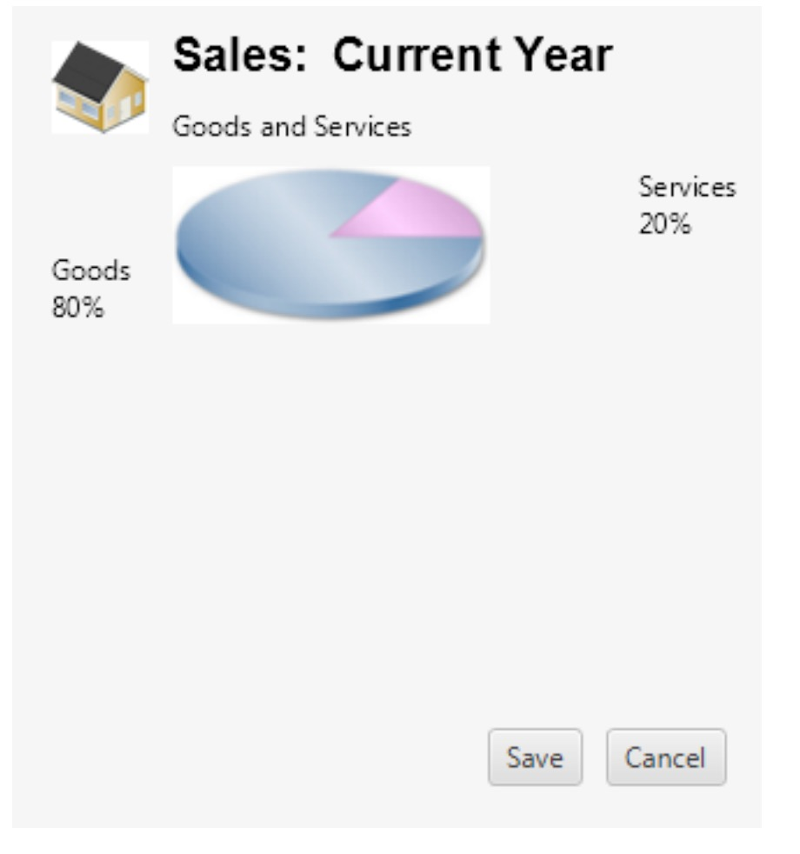
More about AnchorPane please?
12
AnchorPane anchorpane = new AnchorPane();
Button buttonSave = new Button("Save");
Button buttonCancel = new Button("Cancel");
HBox hb = new HBox();
hb.setPadding(new Insets(0, 10, 10, 10));
hb.setSpacing(10);
hb.getChildren().addAll(buttonSave,
buttonCancel);
//Add grid from the previous example
anchorpane.getChildren().addAll(grid,hb);
AnchorPane.setBottomAnchor(hb, 8.0);
AnchorPane.setRightAnchor(hb, 5.0);
AnchorPane.setTopAnchor(grid, 10.0);

Slide 14
JavaFX is a bit ugly ?
13
JavaFX support CSS so we can use CSS to style everything.
It comes with a buid in theme called Modena but we can find Mac themes, Material themes and so on.
We can write our own using CSS selectors, like:
Class Selectors ID Selectors
.button #my-button
.check-box #shaded-hbox
.scroll-bar

Slide 15
JavaFX CSS support more info
14
We can use descendant classes like .check-box .label
We can also use focus selectors like .radio-button:focused or :hover
The CSS rules and properties are defined as described here:
Rule property names correspond to the names of the properties for a class. The convention for property names with multiple words is to separate the words with a hyphen (-). Property names for styles in JavaFX style sheets are preceded by -fx-. Property names and values are separated by a colon (:). Rules are terminated with a semicolon (;).

Slide 16


What !??!
15
.button{
-fx-text-fill: rgb(49, 89, 23);
-fx-border-color: rgb(49, 89, 23);
-fx-border-radius: 5;
-fx-padding: 3 6 6 6;
}
.button1{
-fx-text-fill: #006464;
-fx-background-color: #DFB951;
-fx-border-radius: 20;
-fx-background-radius: 20;
-fx-padding: 5;
}

Slide 17
JavaFX Fancy Login Example

Slide 18
Is there Binding or something in Java FX?
16
JavaFX supports binding for specific set of properties.
This properties are observable and are written like this:
class Bill {
// Define a variable to store the property
private DoubleProperty amountDue = new SimpleDoubleProperty();
// Define a getter for the property's value
public final double getAmountDue(){return amountDue.get();}
// Define a setter for the property's value
public final void setAmountDue(double value){ amountDue.set(value); }
// Define a getter for the property itself
public DoubleProperty amountDueProperty() {return amountDue;}
}

Slide 19
Is there Binding or something in Java FX?
17
When we have observable property we can write observe it.
class Bill {
// Define a variable to store the property
private DoubleProperty amountDue = new SimpleDoubleProperty();
// Define a getter for the property's value
public final double getAmountDue(){return amountDue.get();}
// Define a setter for the property's value
public final void setAmountDue(double value){ amountDue.set(value); }
// Define a getter for the property itself
public DoubleProperty amountDueProperty() {return amountDue;}
}

Slide 20
JavaFX Bindings/ MainObservable Example

Slide 21
Looks like too much work.
18
Each property in each JavaFX component is already observable.
Instead of writing the logic yourself you can use High Level or Low Level API for Binding.
The HighLevel API uses Bindings class and looks like this:
NumberBinding total = Bindings.add(num1.multiply(num2),num3.multiply(num4));
System.out.println(total.getValue());
or LowLevel API which looks like this:
DoubleBinding db = new DoubleBinding() {
{ super.bind(a, b, c, d); }
@Override
protected double computeValue() {
return (a.get() * b.get()) + (c.get() * d.get());
}
};
System.out.println(db.get());
b.set(3);
System.out.println(db.get());

Slide 22
Properties are … kinda ok but what about Collections ?
19
The standard Collections in Java SDK are not observable, however in Desktop Apps we may want to observe a collection for change or bind a collection to a component property.
JavaFX provides a collection API found in javafx.collections package.
It contain 4 important interfaces ObservableList, ObservableMap together with ListChangeListener and MapChangeListener
If we want to make collection observable we should use: FXCollections.observableXXX(nonObservableCollection) which will return an observable collection, now any change in the observable collection should update each components or bindings to that collection.
Keep in mind for Sorting and etc it is better to use utility methods in FXCollections like .sort() instead of in Collections, because of example FXCollections.sort will fire only one change notification instead of hundreds.

Slide 23
JavaFX Collections/ MainObservable Example

Slide 24
JavaFX contains also effects, animations and transitions
20
Effects like Reflection, DropShadow and so on that can even be chained
Transitions that can translate each property from a value to a value with different Interpolations
And even KeyFrame animations that we can fine tune everything.

Slide 25
Do we have time for step by step Animations ?
21
Effects like Reflection, DropShadow and so on that can even be chained
Transitions that can translate each property from a value to a value with different Interpolations
And even KeyFrame animations that we can fine tune everything.

Slide 26
JavaFX Effects chain, Scene Animations and Animations Examples

Slide 27
Can I write like XML ? for the UI
22
Yes instead of writing Java code you can write XML in a declarative way to declare the UI.
This XML is called FXML and have several pluses:
Separation between the UI and the business logic
Using a descriptive language to describe the UI
Possibility to run preview of this FXML without compilation and without any Java code
In order to use FXML you just need to create an example.fxml file describing your scene and just load it into the stage
Parent root = FXMLLoader.load(getClass().getResource(“fxml_example.fxml"));
stage.setScene(new Scene(root, 300, 275));

Slide 28
FXML example(s)

Slide 29
is there.. drag and drop thingy .. ?
23
Yes there is, its called Scene Builder

Slide 30
SceneBuilder Example

Slide 31

Contacts:
https://github.com/gochev
https://twitter.com/gochev
http://facebook.com/gochev
http://linkedin.com/in/gochev
THANK YOU!
If you want to learn more check:
https://youtu.be/8H85iC7SXf0 and https://youtu.be/wIuAVfehme4

